Slide 1

PROGRAMMING FUNDAMENTALS
FALL 2023

Slide 2

WEEK 5

Slide 3
What was COVERED IN WEEK 4
?
Already done !

Slide 4
This Week Goals
Understand and complete functions
Revision class / prepare for sessional
Notes:
Both long int x; and long x; are valid ways to declare a long integer variable, but the former is more explicit and recommended for clarity and readability.

Slide 5
A void function does not return a value.

Slide 6
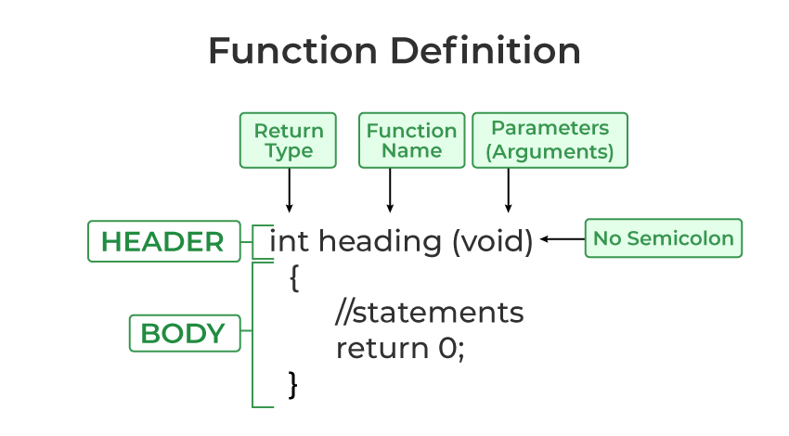

Slide 7
Parameters / arguments
Return 0 ; return x;
Void / int / float
Local / global

Slide 8
Code discussed in detail is already shared in google class room.

Slide 9
Functions have 4 important aspects:
1. they have a name, so we can invoke ("call") them later
2. they specify a return value
3. they can have arguments
4. they have a body, wrapped in curly braces

Slide 10
The function body is the set of instructions that are executed any time we invoke a function.
If the function has no return value, you can use the keyword void before the function name. Otherwise you specify the function return value type ( int for an integer, float for a floating point
Invoke means call

Slide 11
You cannot return more than one value from a function.
A function can have arguments. They are optional. If it does not have them, inside the parentheses we insert void , like this:
void doSomething(void) {
/* ... */
}

Slide 12
void doSomething(int value) {
/* ... */
}
When we invoke the function, we'll pass that parameter in the parentheses, like this:
doSomething(3);

Slide 13
We can have multiple parameters, and if so we separate them using a comma, both in the declaration and in the invocation:
void doSomething(int value1, int value2) {
/* ... */
}
doSomething(3, 4);

Slide 14
void doSomething(int value) {
printf("%d", value);
}

Slide 15
Variable scope
The position determines 2 types of variables:
global variables
local variables
This is the difference: a variable declared inside a function is a local variable,
like this:
int main(void) {
int age = 37;
}

Slide 16
Variable scope
Local variables are only accessible from within the function.
A variable defined outside of a function is a global variable, like in this example:
int age = 37;
int main(void) {
/* ... */
}
Global variables are accessible from any function of the program, and they are available for the whole execution of the program, until it ends.

Slide 17
Variable scope
Access is not limited to reading the value: the variable can be updated by any function. Due to this, global variables are one way we have of sharing the same data
between functions. The main difference with local variables is that the memory allocated for variables is freed once the function ends. Global variables are only freed when the program ends.

Slide 18
WEEK 5 (LEC 10)

Slide 19
(void) ??? As a parameter ?
Revision / Paper pattern / discussion

Slide 20



Slide 21
Sessional 1

Slide 22



THANK YOU

